Slide 1

SEcube Utilities
A.A 2020/2021
Cybersecurity for Embedded Systems
A GUI for the SEcube device and its open source SDK
Referents: Prof. Paolo Ernesto Prinetto, Matteo Fornero, Nicolò Maunero, Gianluca Roascio
Students: Gaetano Galasso, Andrea Pignata, Andrea Russo

Slide 2
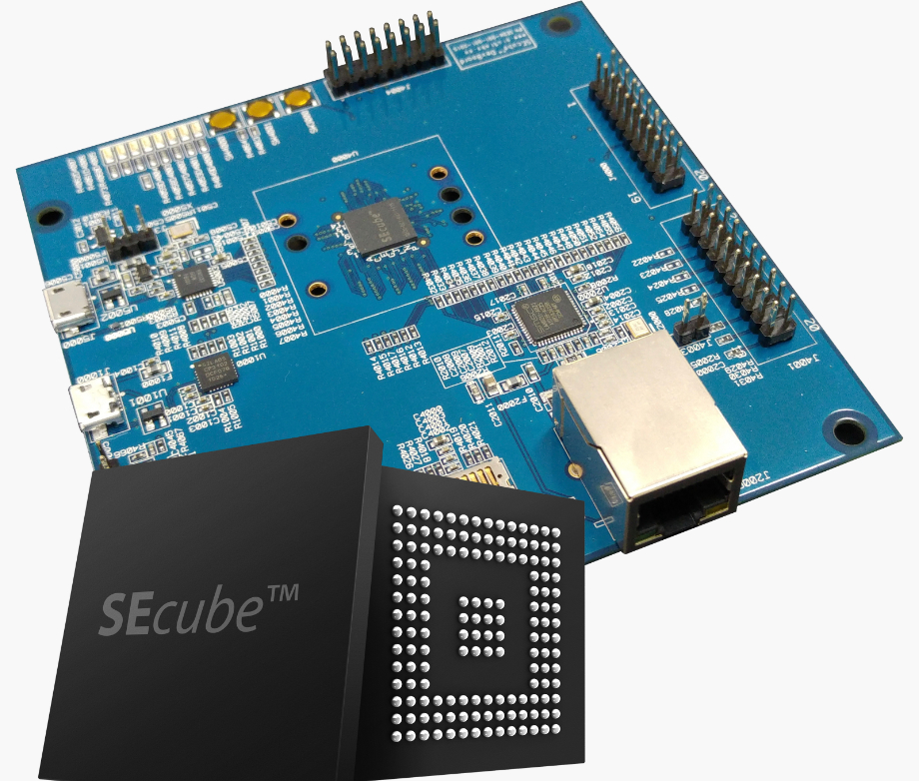
The SEcube
Three main cores in a single chip
Can be defined as a Security Environment
Can be used as security coprocessor for encryption, decryption and digest computation
Advantages of a separate device for key storage and crypto functions: faster and more secure
An Open Source SDK is available

Slide 3
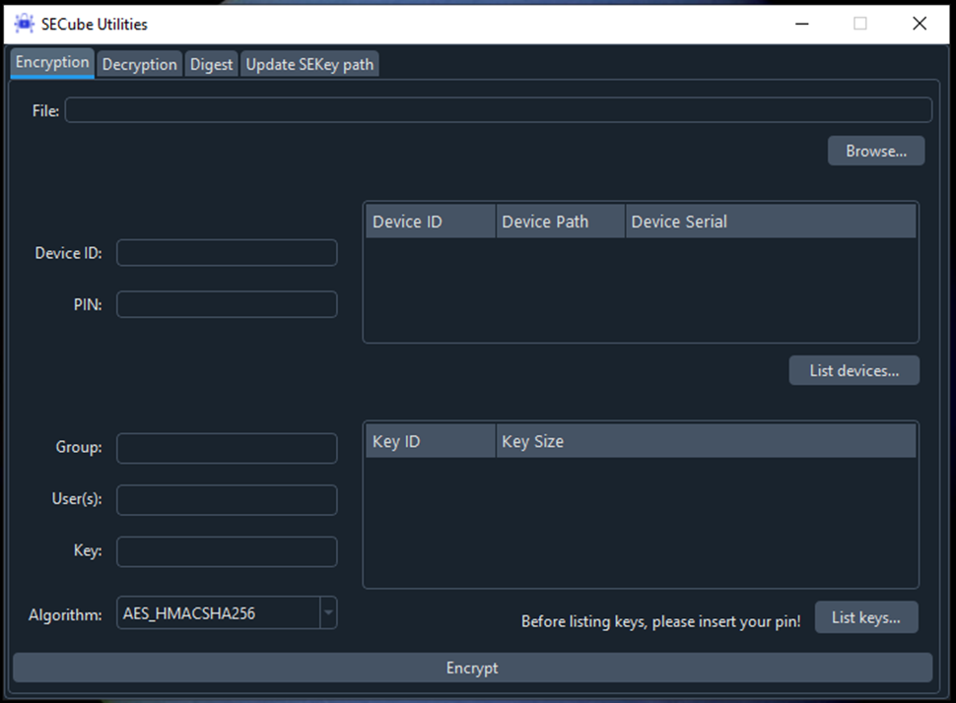
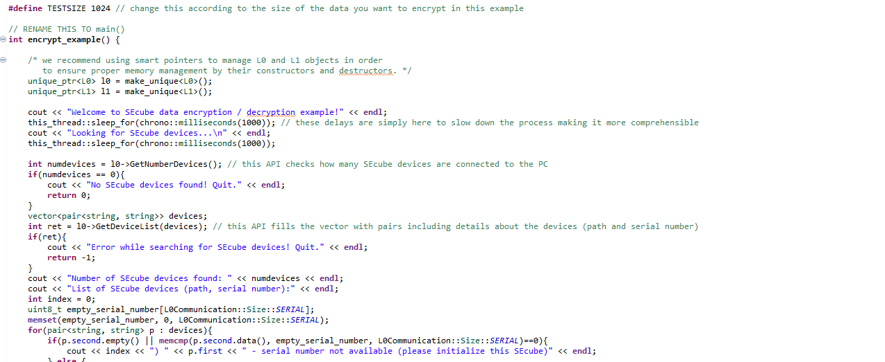

Why SEcube Utilities?
From this…
…to this
🤯
😌

Slide 4
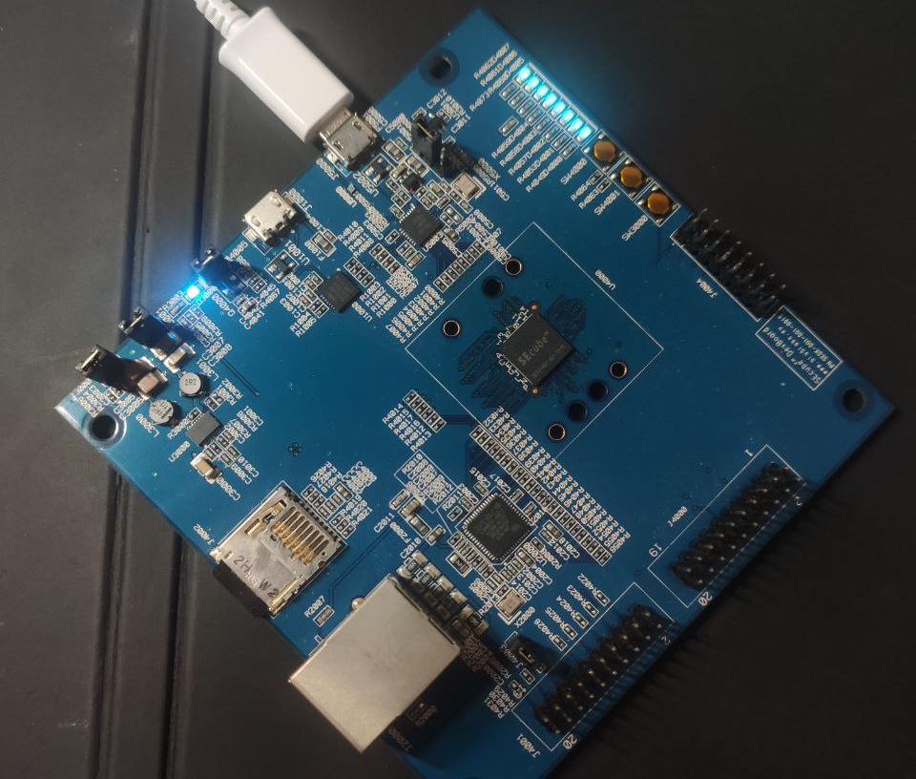
Goals
No more need to write and compile code for each operation…
… but a simple GUI interface
Targeted at the final user
Support for encryption/decryption and digest computation
Compatibility with manual key management, SEkey and SEfile
Compatibility with Linux and Windows

Slide 5
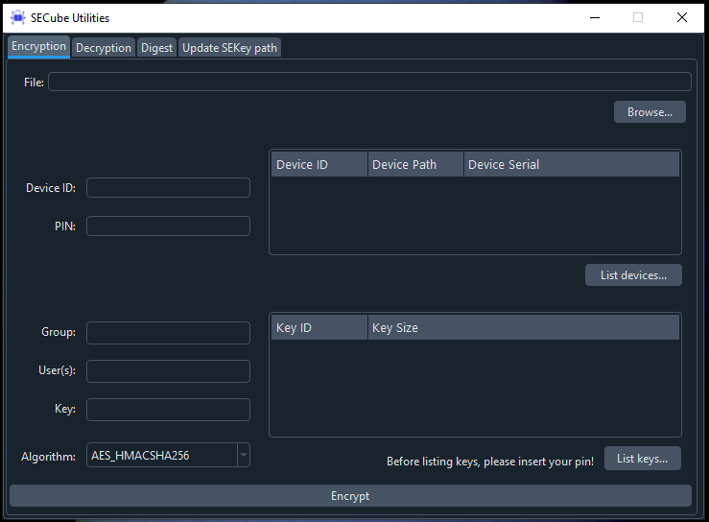
Let’s take a look!
4 main functions
List of connected SEcube devices
Support for SEkey KMS (group or users)
List of keys
(in case of manual management)

Slide 6
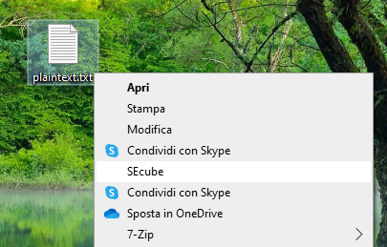
A little advantage for Windows users
…The GUI will launch with the correct file already chosen.

Slide 7
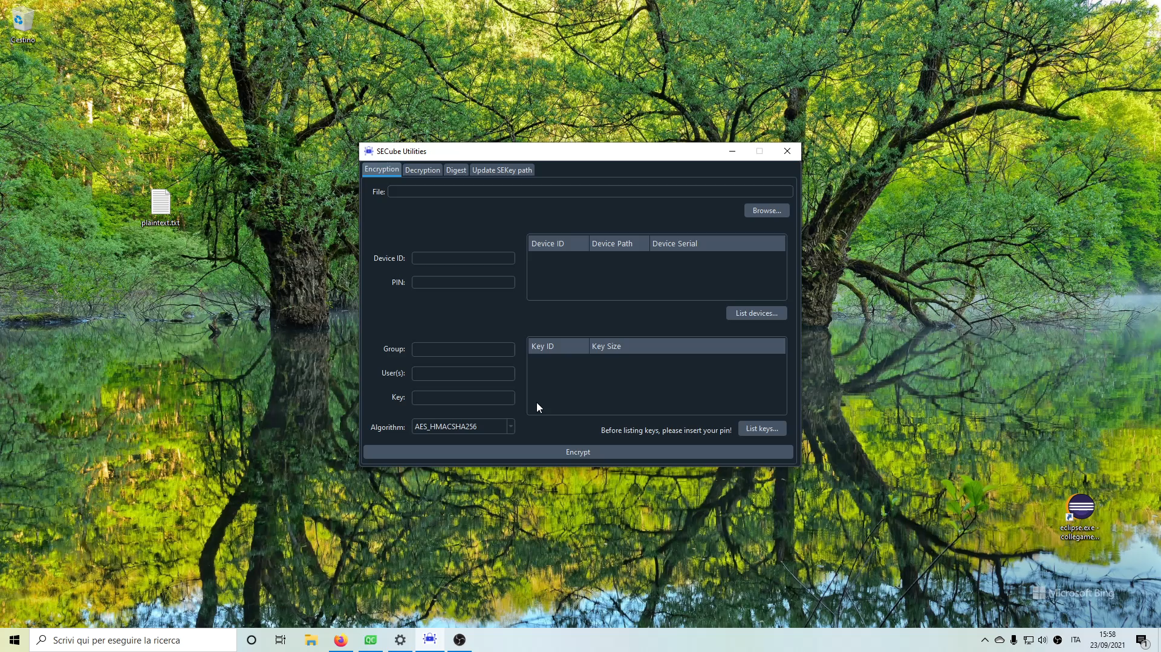
Video demonstration

Slide 8


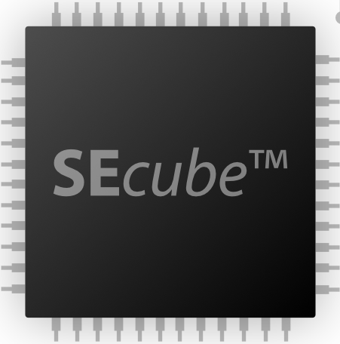
Steps of Implementation
SEcube Utilities GUI
Inter-process sockets
SEcube Utilities Backend
SEcube Open Source SDK
SEcube Device

Slide 9
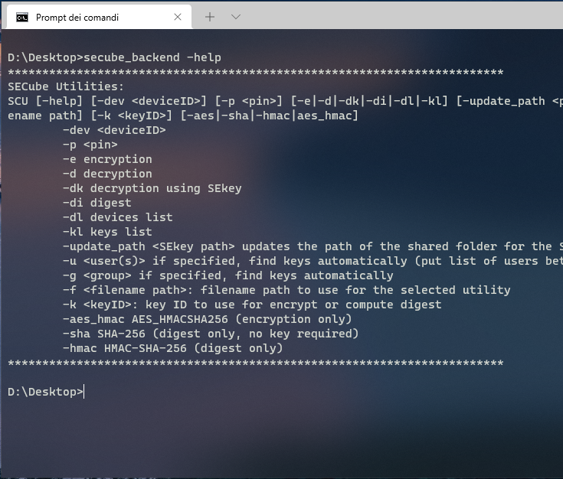
Backend
A byproduct
Fully featured command-line interface, useful for remote servers or under-mainteinance devices
Encryption, Decryption, Digest and some other general utilities
Complete guide can be called with the –help argument
Windows and Linux compatible

Slide 10
Thank you for your attention

